Slide 1
2017/2018 School Year

Slide 2
How do we compare?
*TEA Data Points / Values | Onalaska | POLK CO | ESC6 | TEXAS | District Size 1000/1599 Students
% White | 87 | 56 | 49 | 29 | 48.5
% Two or More Races | 2.2 | 2.6 | 2.4 | 2.1 | 2.1
% Economically Disadvantated | 68 | 71 | 50 | 60 | 58
Attendance Rate | 96.2 | 96 | 96 | 96 | 95.8
4 Year Longitudinal Gad Rate Class of 2015 | 98.2 | 96 | 91 | 89 | 91.2
5 Year Longitudinal Grad Rate Class of 2014 | 94.1 | 93 | 91 | 90 | 92.3
All Subjects - STAAR | 78 | 64 | 76 | 75 | 75
Reading/ELA - STAAR | 75 | 64 | 74 | 73 | 74
Writing - STAAR | 70 | 61 | 70 | 69 | 70
Mathematics - STAAR | 82 | 63 | 77 | 76 | 76
Science - STAAR | 79 | 70 | 80 | 79 | 78
Social Studies - STAAR | 83 | 60 | 77 | 77 | 75
White Students - STAAR | 79 | 62 | 83 | 85 | 81
Economically Disadvantated Students - STAAR | 72 | 59 | 65 | 67 | 67
SAT-Average Score | 1396 | 1210 | 1487 | 1394 | 1404
*From TEA’s Most Recent District Snapshots

Slide 3
*TEA Data Points / Values | Onalaska | POLK CO | ESC6 | TEXAS | District Size 500/999 Students | *From TEA’s Most Recent District Snapshots
% Revenue from State | 32 | 33.8 | 36 | 41 | 48.3
% Revenue from Local and Other | 58 | 53 | 57 | 49 | 41.5
% Revenue from Federal | 10 | 11 | 8 | 10 | 10.2
Total Operating Expenditures Per Pupil | 10,076 | 10,582 | 8,709 | 9,065 | 9,647
% Instructional Expenditures | 55 | 52 | 56.9 | 56.9 | 54
Total Instructional Expenditures Per Pupil | 5,536 | 5,680 | 4,958 | 5,158 | 5,235
% Regular Education Expenditures | 61.4 | 59 | 60.6 | 60 | 58.3 | UIL District 21-AAA
% of Total Budget to Athletics/Related Activities Expenditures | 0.9 | 4.2 | 3.3 | 2.6 | 4.7 | 5.2

Slide 4
Take a Look Back
10 Years Ago
TEA Data VS Most Recent District Snapshots
In ALL tests taken OISD trailed the State by 10 points - Currently lead the State by 7 points
In math OISD trailed the State by 10 points- Currently lead the State by 6 points
In social studies OISD trailed State by 13 points - Currently lead the State by 6 points
In reading/ELA, writing and science, OISD matched the State average - Currently OISD leads the State average in these tests by an average of 6 points
OISD SAT scores were 150 points below the State average -Currently OISD matches the State average

Slide 5
OISD Historical Enrollment Report
2006-2007 to Present
 | ELEM |  | JSHS |  | TOTAL
2006-2007 | 482 |  | 373 |  | 855
2007-2008 | 517 | 35 | 374 | 1 | 891 | 36
2008-2009 | 543 | 26 | 362 | -12 | 905 | 14
2009-2010 | 570 | 27 | 378 | 16 | 948 | 43
2010-2011 | 554 | -16 | 403 | 25 | 957 | 9
2011-2012 | 577 | 23 | 375 | -28 | 952 | -5
2012-2013 | 584 | 7 | 366 | -9 | 950 | -2
2013-2014 | 555 | -29 | 359 | -7 | 914 | -36
2014-2015 | 538 | -17 | 357 | -2 | 895 | -19
2015-2016 | 607 | 69 | 377 | 20 | 984 | 89
2016-2017 | 628 | 21 | 399 | 22 | 1027 | 43
2017-2018 | 676 | 48 | 441 | 42 | 1117 | 90
 |  | 194 |  | 68 |  | 262

Slide 6
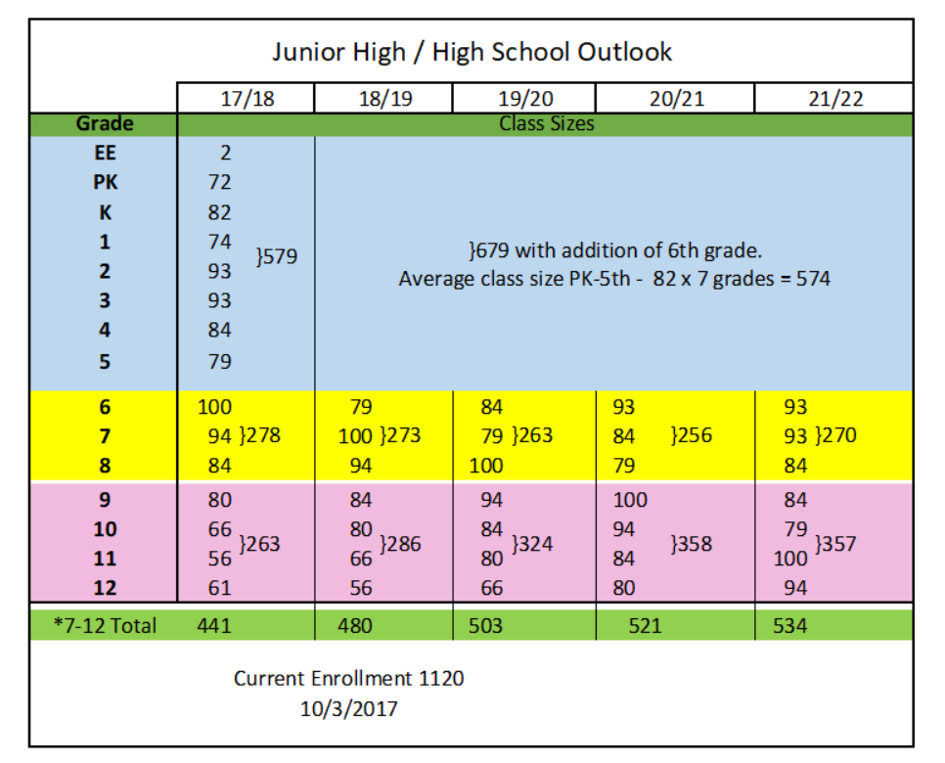
Enrollment Outlook

Slide 7
August 2017
Enrollment 1115
Property Value $600,460,631
Fund Balance $4,595,329
2014-2017 Fund Balance Grew $877,183
Current monthly operating costs $790,000 (Sept. 2017)
3 month operating costs $2,370,000
6 month operating costs $4,740,000
Consistently rated Superior by TEA Financial Integrity Rating System of Texas
OISD is considered a Chapter 41 District *not in recapture

Slide 8
Employee Summary for 2017-2018
Professional: 12
(Superintendent, Principals, AP’s
Counselors, Instructional Specialists,
AD, Curriculum & Special Programs)
Teachers: 78
Auxiliary Paraprofessionals: 30
Auxiliary Clerical/Other: 9
(Nurse, Secretaries, Admin Assistant, Registrars)
Cafeteria: 13
Custodial: 10
Maintenance: 7
Technology: 3
Transportation: 13
(5 have dual role as Para or Teacher)
Total Employees: 175

Slide 9
Transportation Report
Department Stats:
72 Sq. Miles in District
12 Regular Education Bus Routes
1 Special Education Bus Route
12 Route Buses
3 Trip Buses
11 Full Time Drivers
3 Full Time Employees
0 Substitutes
Est. Regular Bus 351 miles/day
Est. Special Education Bus 80 miles/day
Department Future Needs:
Special Needs Bus
77 passenger Regular School Bus

Slide 10
Technology Report
New Technology Purchases for 2017-18:
PC upgrades for entire district (371 devices)
iPads (20 devices)
Tablets (15 devices)
Chromebooks (195 devices)
Chrome carts (9 carts)
Computer lab tables (30 tables)
PCs (with monitor, keyboard & mouse): 492 (-67)
Student: 380 (OES: 172 OJSH: 208)
Teacher/staff: 112 (OES: 58 OJSH: 54)
Laptops: 25
OES: 25
Tablets: 33 (+15)
OES (PreK & 1st): 33
Chromebooks: 603 (+195)
OES: 130
OJSH: 366
PDC: 30
Chrome carts: 21 (+9)
OES: 5
OJSH: 15
PDC: 1
iPads: 52 (+17)
OES (K &2nd) 41
OJSH Science: 7
OJSH Yearbook: 4
Document Cameras: 54 (+5)
OES: 40
OJSH: 13
PDC: 1
e-Beams: 66 (+6)
OES: 42
OJSH: 23
PDC: 1
Smart Boards: 3 (-7)
TI N-Spire Handhelds: 180 OJSH (Math & Chemistry) (+41)
InFocus Projectors: 95

Slide 11
Technology Upgrade Schedule
Phase 1: Purchase, set-up, replace/upgrade
-Spring 2017: Purchase 371 PC’s for entire district: COMPLETED
-Summer 2017: Set up & replace staff/faculty PC’s for entire district (approx. 118)
Teachers: COMPLETED
Staff: IN PROGRESS
-Set up student PC’s for new Information Technology Lab at OJSH COMPLETED
-Fall 2017: Set up and replace student PC’s at OES: IN PROGRESS
-Organize Upgrade schedule for Chromebooks/devices IN PROGRESS
-Spring 2018: Set up and replace student PC’s at OJSH five labs: COMPLETED
-Student PC’s in classrooms: IN PROGRESS
Phase 2: Transition to Windows 10
-Summer 2019: transition staff/faculty to Windows 10
-2019-20: transition student PC’s to Windows 10
-Transition all other devices, programs, etc.. to Windows 10
Phase 3: Upgrade Schedule Rotation
-Start rotating Upgrade schedule for 492PC’s (3-5 yrs.) PC’s would be purchased the semester/summer prior to implementation to allow for imaging, loading software, set-up, installs, etc.. -Fall/Spring 2020-21: OES K-3 Lab, OES 4-6 Lab, OJSH 106 Lab
-Summer 2021: Staff/Faculty district wide
-Fall 2021: OES students
-Spring 2022: OJSH Students

Slide 12
Child Nutrition Report
2016-2017
Basic Claim reimbursed $468,003.06
Served 115,876 Lunch
Served 97,437 Breakfast
Served 4,016 Summer Feeding Program Meals creating approximately $13,052.16 in income.
September 2016 Basic Claim reimbursed $58, 821 and September 2017 Basic Claim reimbursed $79,580
Basic Claim Reimbursement was up 26% over 2016
Purchases:
2 Ice Machines
2 Ice Cream Freezers
Replenished Small wares
Department Stats:
2016-2017 to Date, this program has been operating in budget. No local funds contributed.
Have 13 employees- 9 full time; 4 part time
0 substitutes
Cover special events: Read Well, Honor’s Dinner, Teacher Meals and After School Snacks
High School offers at least 7 different meals a day
Elementary offers at least 4 different meals a day

Slide 13
Custodial Report
Department Stats:
9 Employees
206,325 Square Feet to Clean
Allow 10-12 minutes per classroom to clean
Additionally maintains gym, weight room, Ag Barn, Snack Bar, Locker Rooms and Administration Building as well as summer cleaning: remove all furniture, strip and wax total district.
Clean windows
Shampoo and vacuum carpets

Slide 14
Maintenance Report
Department Stats:
Maintenance-
5 employees
206,325 Square Feet of buildings and facilities
Repair or replace A/C units- Replaced 4 units
Remodeled Admin Office
Maintain all equipment for kitchens, Ag, classrooms
Build fences, gates
Fabricated parts
Repair all electrical
Maintain all sports facilities
Maintains District equipment
Repairs or replaces all locks and keys
Does shipping and receiving of all packages coming in and going out of District
Pest control
Custom wood work
Grounds-
1 Employee
Maintains grounds in District
Maintains Baseball fields for school as well as Baseball and Softball Practice fields for Little League
Repairs and services own equipment
Also helps where needed with other District jobs
Repairs all irrigation equipment

Slide 15
Onalaska ISD 2016-2017 FIRST Rating

Slide 16
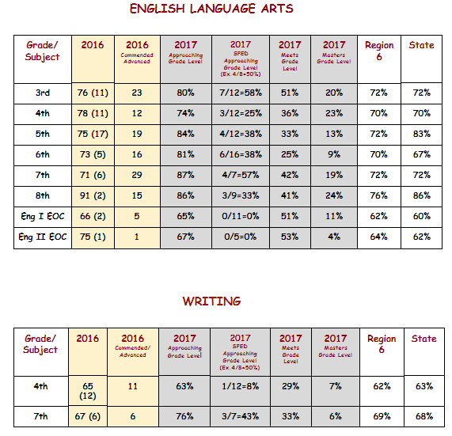
2017 Accountability Report (Percent Passing)

Slide 17
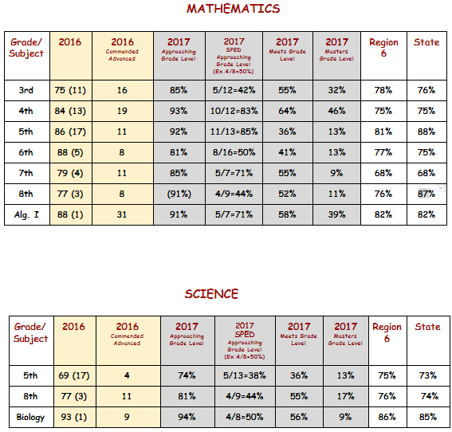
2017 Accountability Report (Percent Passing)

Slide 18
2017 Accountability Report (Percent Passing)

Slide 19
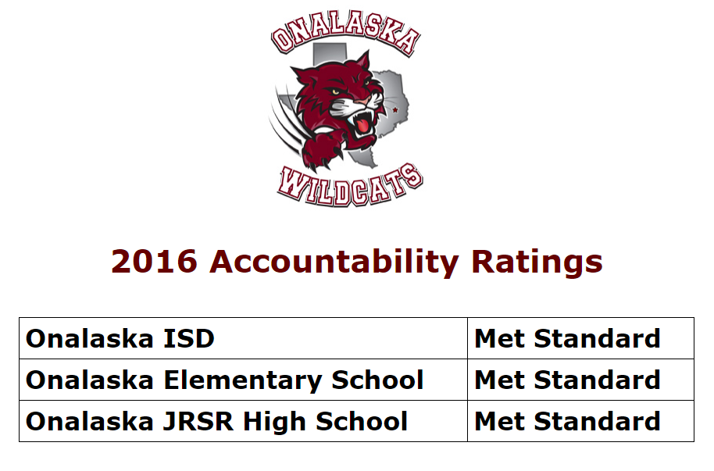
2017 Accountability Report

Slide 20
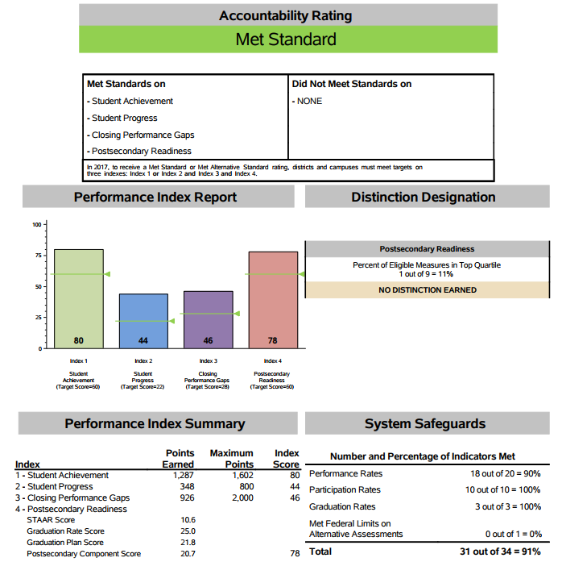
2017 Accountability Summary - District

Slide 21
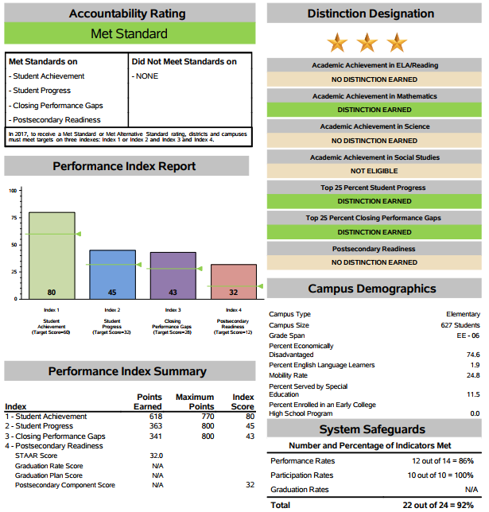
2017 Accountability Summary – Elementary/Intermediate

Slide 22
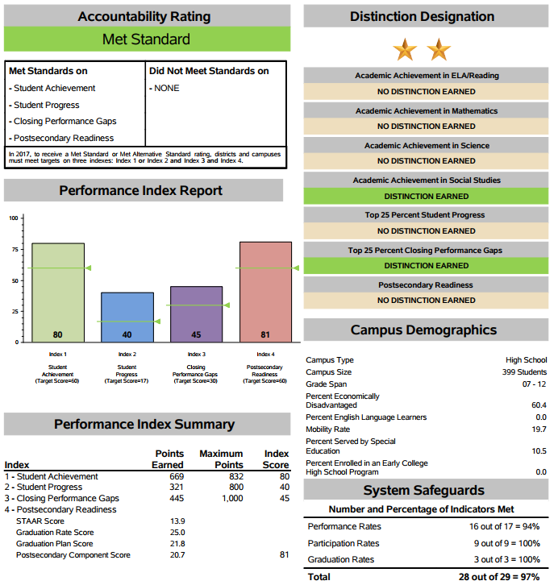
2017 Accountability Summary – Junior Senior High

