Slide 1


2019-20
Annual Report
Public Hearing
Onalaska ISD
February 22, 2021

Slide 2
7 Sections to the Annual Report
2019-20 Texas Academic Performance Report (PDF TAPR)
  For the District and each Campus in the District
PEIMS Financial Standard Report (2018-19 Financial Actual Report)
  For the District and each Campus in the District
2019-20 District Accreditation Status
Campus Performance Objectives
Report on Violent or Criminal Incidents on Campuses
Student Performance in Postsecondary Institutions
  For each High School Campus in the District
2019-20 TAPR Glossary

Slide 3
Section 1
2019-20 Texas Academic Performance Report (TAPR)
Compiled by TEA for every district and campus using
  PEIMS
  Student Assessment Data
TAPR is published in 2 different formats
  A comprehensive, “dynamic” online data system
    Data are added as they become available
  A PDF version (the “PDF TAPR”)
    Only includes major, statutorily-required data points
    Designed to allow districts to fulfill their public notification requirements (i.e., this Annual Report)

Slide 4
Section 1
2019-20 Texas Academic Performance Report (TAPR)
Cover Page
  2020 Accountability Rating
    Same rating for the district and all campuses: Not Rated: Declared State of Disaster
  2020 Special Education Determination Status
    Only reported on the district’s TAPR
  2020 Armed Services Vocational Aptitude Battery (ASVAB) Test
    Only reported on the district’s TAPR and only reported if the District did not offer the ASVAB Career Exploration Program and did not request a waiver from TEA
  2020 Distinction Designations
    No Distinction Designations were awarded at the district or campus level in 2020 due to the absence of 2020 STAAR data

Slide 5
Section 1
2019-20 Texas Academic Performance Report (TAPR)
STAAR Performance
  All 3 performance rates
    Approaches Grade Level or Above
    Meets Grade Level or Above
    Masters Grade Level
  Reported for
    Each Assessment
    All Grades All Subjects
    All Grades by Subject
STAAR – Academic Growth
  Only calculated in Reading (Grades 4-8 and English II) and Math (Grades 4-8 and Algebra I)
  Reported by Grade and Subject
Due to the cancellation of Spring 2020 STAAR assessments, the data for these measures have not been updated. Therefore, the data that are reported are identical to the data reported in the 2018-19 TAPR.

Slide 6
Section 1
2019-20 Texas Academic Performance Report (TAPR)
STAAR - Prior Year and Student Success Initiative
  Progress of Prior Year Non-Proficient Students
  Student Success Initiative (SSI)
Bilingual Education/English as a Second Language
  Includes STAAR performance and academic growth measures (disaggregated by various program instructional models) for students identified as current ELs in the 2019-20 school year
STAAR Participation
Due to the cancellation of Spring 2020 STAAR assessments, the data for these measures have not been updated. Therefore, the data that are reported are identical to the data reported in the 2018-19 TAPR.

Slide 7
Section 1
2019-20 Texas Academic Performance Report (TAPR)
Attendance, Graduation, and Dropout Rates
  Attendance Rate
  Annual Dropout Rate (Gr. 7-8 and Gr. 9-12)
  4-year Longitudinal Graduation Rates (State and Federal Rates)
  5-year Extended Longitudinal Graduation Rates (State)
  6-year Extended Longitudinal Graduation Rates (State)
  Graduation Plan Rates (Longitudinal and Annual)
Graduation Profile
  The most recent data for these measures are from the 2018-19 school year. Therefore, performance on these measures has been updated since the 2018-19 TAPR and is reported for the 2018-19 and 2017-18 school years.

Slide 8
Section 1
2019-20 Texas Academic Performance Report (TAPR)
College, Career and Military Readiness (CCMR)
  CCMR Graduates
  College Ready Graduates
  Career/Military Ready Graduates
CCMR-Related Indicators
  TSIA Results
  CTE Coherent Sequence
  Completed and Received Credit for College Prep Courses
  AP/IB Results
  SAT/ACT Results
Other Postsecondary Indicators
  Advanced Dual-Credit Course Completion
  Graduates Enrolled in Texas Institutions of Higher Education (TX IHE)
  Graduates in TX IHE Completing One Year Without Enrollment in a Developmental Education Course
  The most recent data for these measures are from the 2018-19 school year. Therefore, performance on these measures has been updated since the 2018-19 TAPR and is reported for the 2018-19 and 2017-18 school years.

Slide 9
Section 1
2019-20 Texas Academic Performance Report (TAPR)
Student Information
  Student enrollment (including enrollment by grade level, by ethnicity, by certain student identification indicators, and students with disabilities by primary eligibility category) and other student information (including graduation information, retention rates, and class size information)
Staff Information
  Staff information (including total staff, staff by classification, teachers by ethnicity and gender, teachers by highest degree held and years of experience, experience of campus leadership, staff salary, and teacher turnover rate information)
Program Information
  Student Enrollment by Program
  Teachers by Program (population served)
  The most recent data for this information are from the 2019-20 school year.

Slide 10
Section 2
PEIMS Financial Standard Reports (2018-19 Financial Actual Reports)
2018-19 Actual Financial Data
(District)
Revenues
Expenditures
Disbursements
Tax Rates
Fund Balance
2018-19 Actual Financial Data
(Campus)
Expenditures by Object
Expenditures by Function
Program Expenditures by Program
  2018-19 is the most recent year for which these data are available.

Slide 11
Section 3
2019-20 District Accreditation Status
Each year, TEA assigns one of four accreditation statuses to each district in the state:
  Accredited
  Accredited-Warned
  Accredited-Probation
  Not Accredited-Revoked
In assigning an accreditation status to a district, TEA considers
  Academic accountability ratings
  Financial accountability ratings
  Data integrity
  Program-area deficiencies identified through Results Driven Accountability (RDA)
The District’s 2019-20 Accreditation Status is: Accredited

Slide 12
Section 4
Campus Performance Objectives
Campus Improvement Plans (CIP)
  Each campus has developed and is implementing a CIP, as required by TEC §11.253
  Each CIP includes performance objectives (approved by the Board) that are based on data analysis and needs assessments – including data reported in annual TAPR reports
  Each campus periodically measures progress toward its performance objectives
  Updated CIPs for the 2019-20 school year (which show each campus’s progress toward meeting its performance objectives) are posted on the district’s website and are available for review at the district’s central office or at the applicable campus

Slide 13
Section 5
Report on Violent or Criminal Incidents
TEC Section 39.306 requires each district to publish, as part of its Annual Report, a report on violent or criminal incidents that occur at each campus
The report must include
  Number, rate and type of violent or criminal incidents that occurred on each campus (to the extent permitted under FERPA)
  Descriptions of school violence prevention and violence intervention policies and procedures used to protect students
  Findings from evaluations (if any) conducted under the Safe and Drug-Free Schools and Communities Act
The district’s report for the 2019-20 school year is available for review at the district’s central office and at each campus in the district

Slide 14
Section 6
Student Performance in Postsecondary Institutions
TEC Section 39.306 requires each district to publish, as part of its Annual Report, a report on student performance in postsecondary institutions during the first year enrolled after graduation from high school
These data are compiled by the Texas Higher Education Coordinating Board (THECB)
The most current report is for 2017-18 High School Graduates
  Student performance is measured by the Grade Point Average (GPA) earned by 2017-18 high school graduates who attended public four-year and two-year institutions of higher education in fiscal year 2019
  For each student, the grade points and college-level semester credit hours earned by the student in Fall 2018, Spring 2019, and Summer 2019 are added together and averaged to determine the GPA

Slide 15
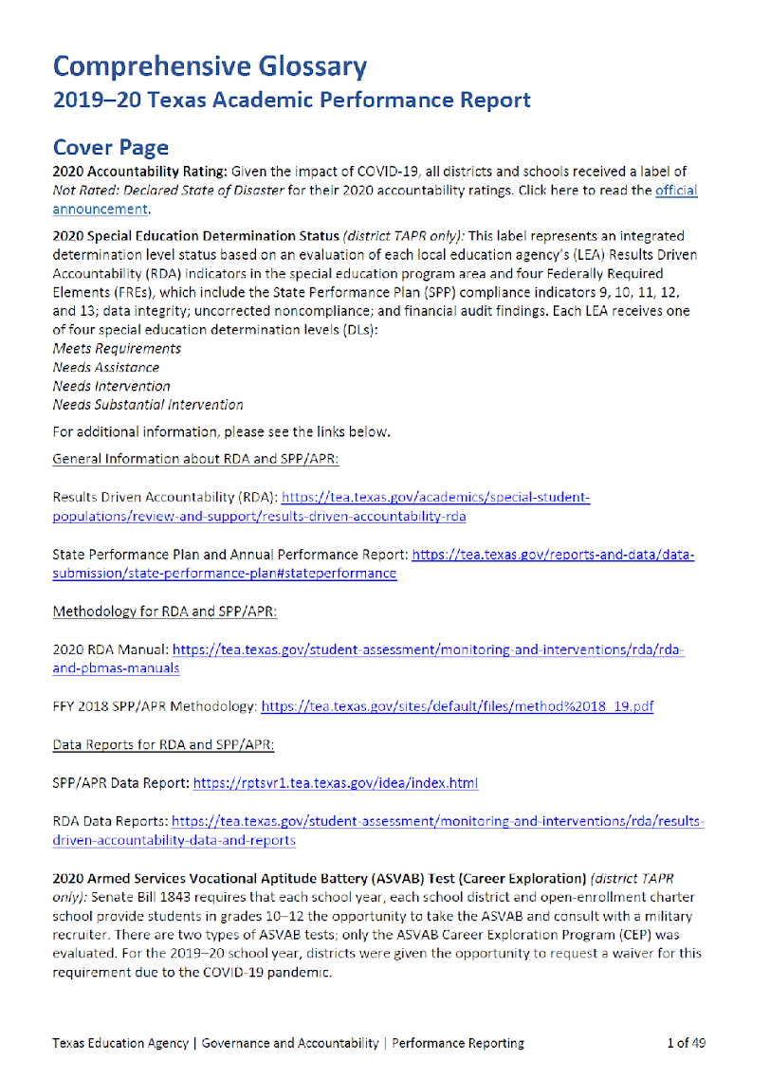
Section 7
TAPR Glossary
Each year, TEA prepares and publishes a TAPR Glossary
The TAPR Glossary provides definitions, describes methodologies, and lists sources for each data point in the TAPR
A Spanish version of the TAPR Glossary is scheduled for release in late winter

Slide 16
Resources and Availability of Annual Report
The District’s TAPR will be posted on the district’s website within 2 weeks after this meeting
Paper copies will also be available at the district’s central office and on each campus in the district
For questions or more information, contact:
Name | Laura Redden
Position | Assistant Superintendent
Phone | 936-646-1023
Email | laredden@onalaskaisd.net

